Slide 1

OHOS Animation

Slide 2
Today’s Session is about
Overview
OHOS Animation
FrameAnimationElement
CurveType
Q & A

Slide 3
Overview
1

Slide 4
Overview
In Mobile programming the general rule is, when your UI changes in response to user action, you should animate the View as well as layout transitions.
Animations are very much essential when designing Custom Components like ProgressBar, Page Sliders, Popups, especially FAB Button animations and much more.
Further Animation also adds a rich look and feel to your app.

Slide 5
Overview
No doubt, we can use the feature of the play button without using animation also, but if you use animation then it looks more interactive i.e. by using animation, we are not abruptly changing the UI of the application.

Slide 6
OHOS Animation
2
Let’s see animation framework

Slide 7
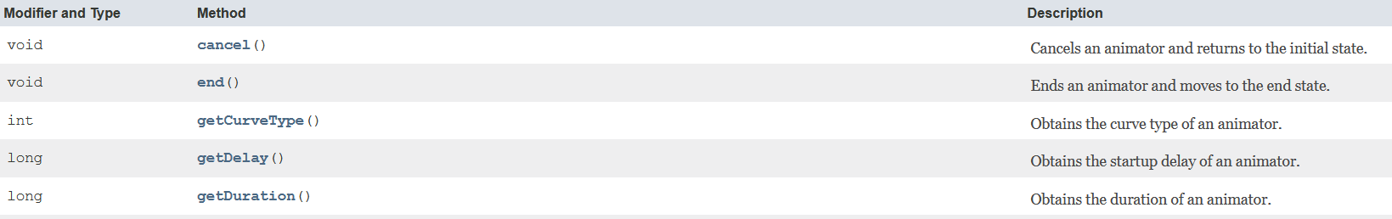
OHOS Animation - Animator
Animator class provides basic support for animators. Besides starting, stopping, pausing, and resuming the animator, it allows you to obtain the animator duration, startup delay, repetition times, and specified curve types.
The OHOS Animation framework provides three major classes for animation: AnimatorValue, AnimatorProperty, and AnimatorGroup all of which inherits from Animator.

Slide 8
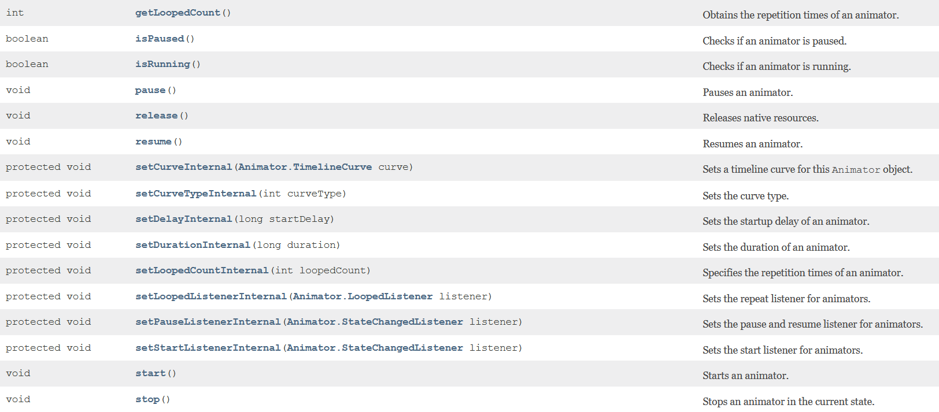

Slide 9
OHOS Animation - AnimatorValue
AnimatorValue internally maintains a timing engine for running animation which calculates the animated values and set them on the target objects.
By AnimatorValue you can animate a Component’s properties such as width, height, alpha, update its x and y coordinates or even can change its background.
By AnimatorValue we will be able to update any Object property other than Component properties. (Example here is ProgressBar)
It has an interface AnimatorValue.ValueUpdateListener which is used to receive callbacks on every animation frame.
The following describes how to use AnimatorValue to implement an animation.

Slide 10
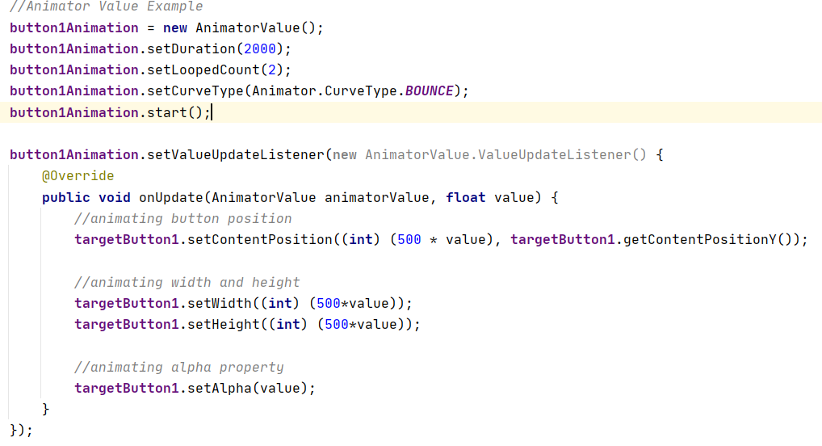

Slide 11
OHOS Animation - AnimatorProperty
To move, reveal, or hide Components within the current layout, you can use the AnimatorProperty provided by the ohos.agp.animation package, available in OHOS.
AnimatorProperty update the Component properties over a period of time, continuously redrawing the Component as the properties change.
For example, when you change the position properties, the Component moves across the screen, or when you change the alpha property, the Component fades in or out.
The following section lists API’s and describes how to use AnimatorProperty to implement an animation.

Slide 12
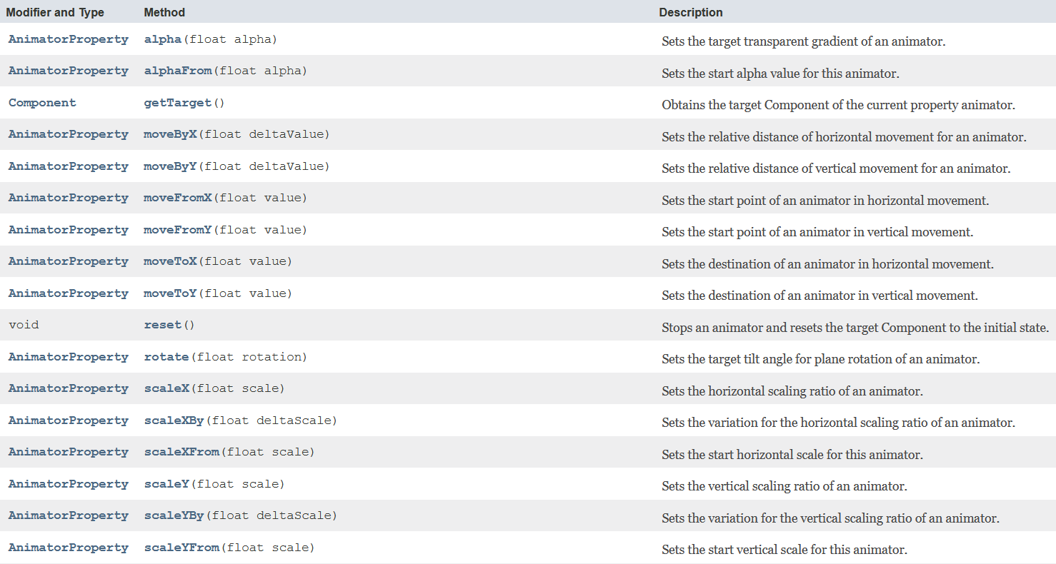

Slide 13
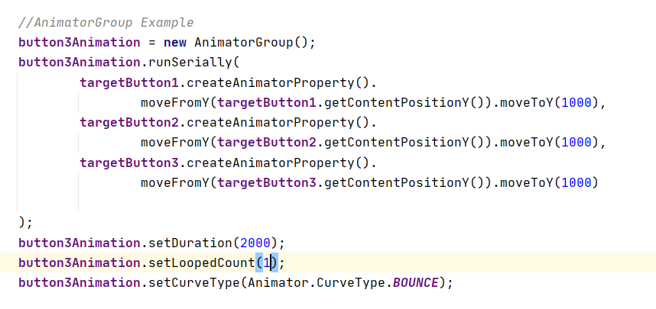
OHOS Animation - AnimatorGroup
You can bundle multiple animations into an AnimatorGroup, and use runSerially() or runParallel() to play these animations sequentially or simultaneously. The code snippets below describe how to use an AnimatorGroup.

Slide 14
FrameAnimationElement
FrameAnimationElement creates a frame-by-frame animation by displaying a series of images in sequence, so that human eyes will perceive the images as moving ones.
In the Project window, choose entry > src > main > resources > base > media, and add a set of pictures to the media directory.
Create an animation_element.xml file under the graphic directory and declare image resources in the animation-list section. duration specifies how long the animation will last, in the unit of milliseconds. oneshot specifies whether the animation is played only once.

Slide 15
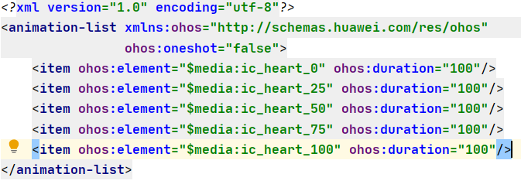
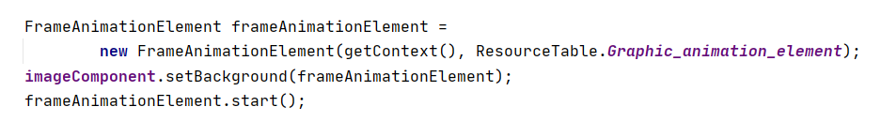
FrameAnimationElement

Slide 16
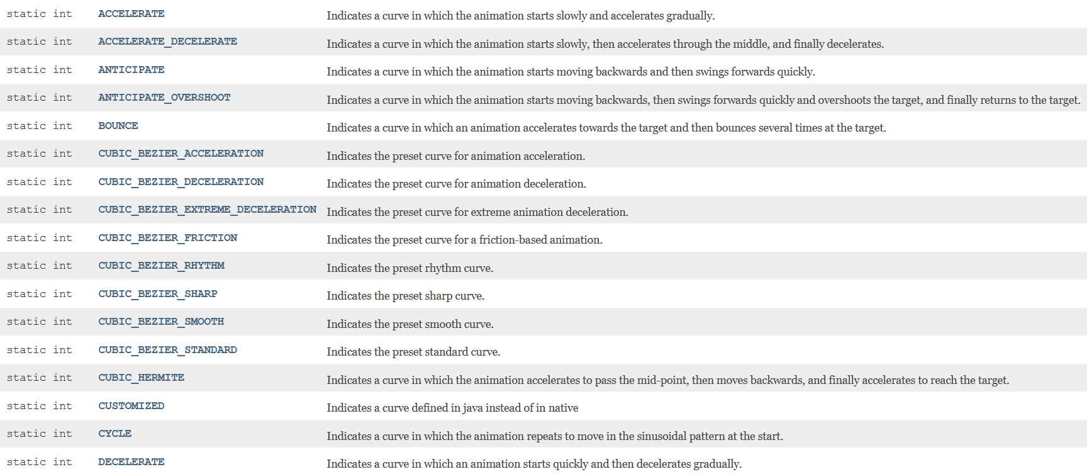
CurveType
CurveType defines rate of change of an Animation. This allows basic animation to be accelerated, decelerated, repeated etc.

Slide 17
THANKS!
Any questions?

